Slide 1
ResSI - Aufgaben
Secure Programming

Slide 2
ziptool - strncat(3)
switch(oper)
{
case MOUNT_DISK:
strncpy(cmd, MOUNT_CMD, strlen(MOUNT_CMD)+1);
strncat(cmd, “ -t ext2 “, 9);
strncat(cmd, dev, strlen(dev)+1);
strncat(cmd, “ “, 1);
...

Slide 3
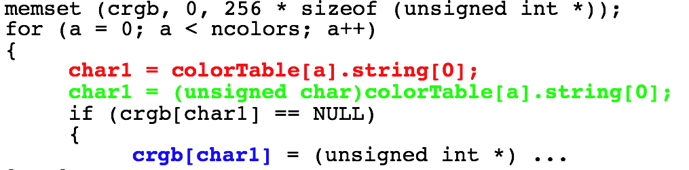
smalltalk: Type Mismatch

Slide 4
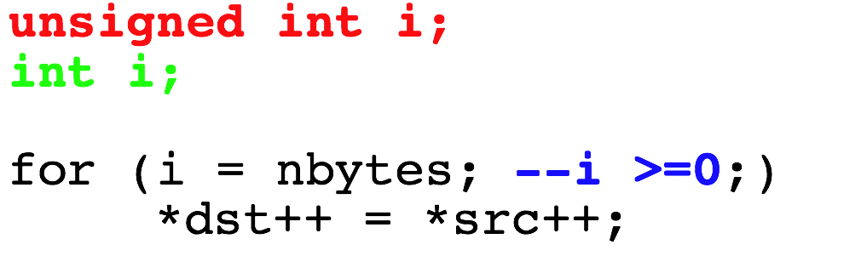
X11: Signed Issue?

Slide 5
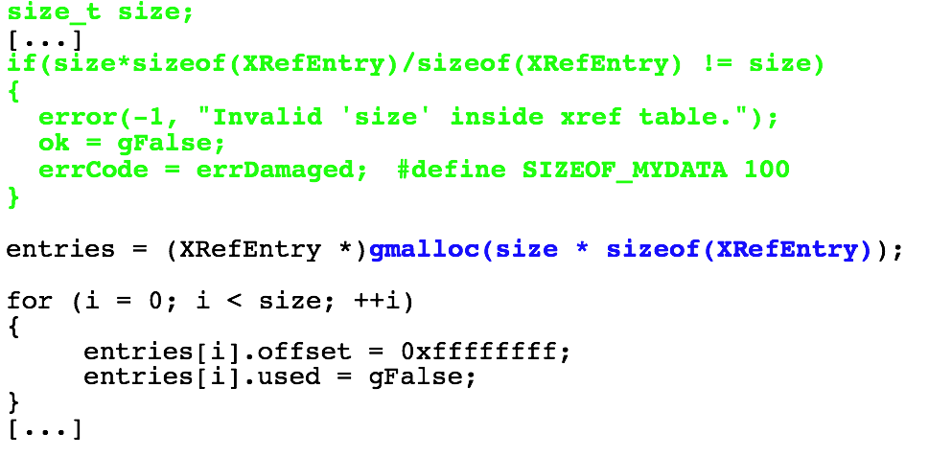
xpdf: 32 Bit vs. 64 Bit

Slide 6
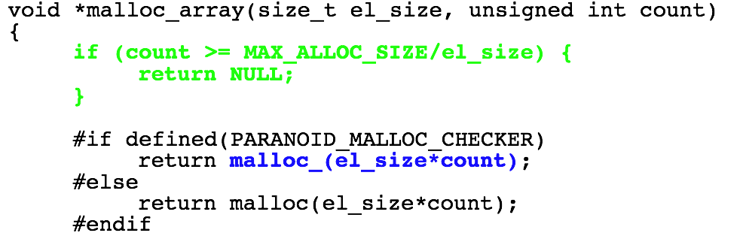
Samba: Valgrind is evil ;-)

Slide 7
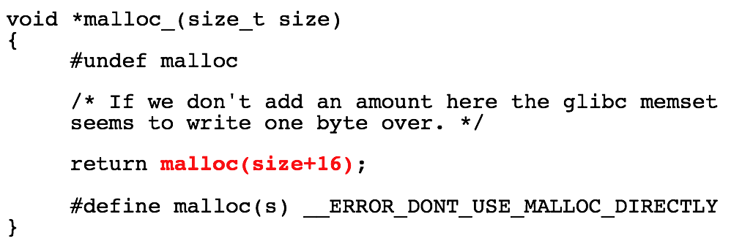
Samba: Valgrind is evil ;-)

Slide 8
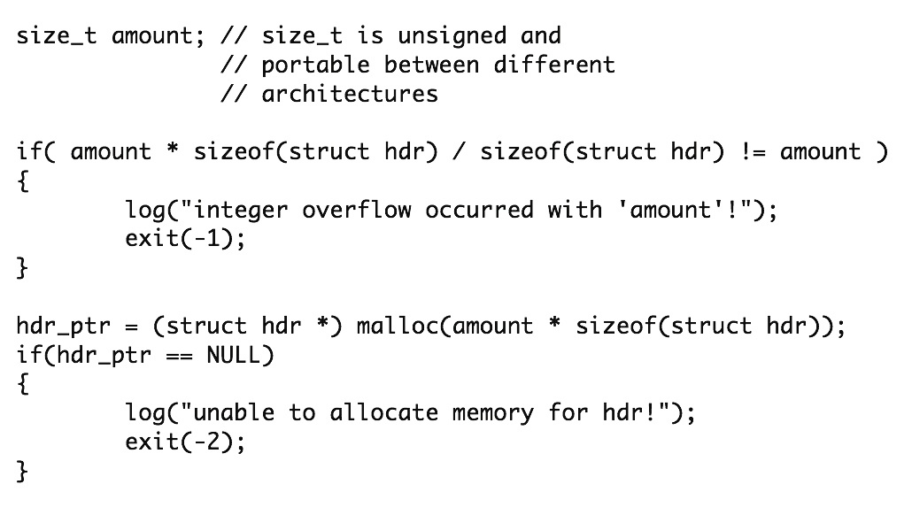
Test

Slide 9
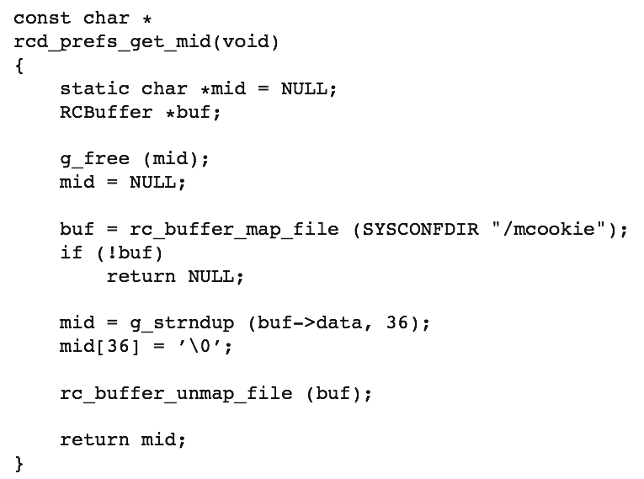
RC Server (multi-threaded)

Slide 10
RC Server (multi-threaded)
Double Free Bug due to missing Locking in multi-threaded Situation
  Result: Crash!
Lessons learned:
  use Locking
  do not use static Buffers

Slide 11
CASA’s Unix Domain Socket
sockEndPoint = new UnixEndPoint(socketFileName);
UnixFileSystemInfo sockFileInfo =
new UnixFileInfo(socketFileName);
UnixUserInfo sockFileOwner = sockFileInfo.OwnerUser;
// root is the owner of the file "/tmp/.novellCASA"
if (sockFileOwner.UserId == 0)
{
mSocket.Connect(sockEndPoint);
}
else
{
throw new Exception("not a valid miCASA service");
}

Slide 12
CASA’s Unix Domain Socket - The Attack
Attacker: ln -s /etc/passwd /tmp/.novellCASA
CASA: calls UnixEndPoint(/tmp/.novellCASA)
CASA: UnixFileInfo() is a Wrapper for stat(2) and follows symbolic Links: stat(/etc/passwd)
CASA: /etc/passwd is root-owned and therefore the Check for the Ownership succeeds

Slide 13
CASA’s Unix Domain Socket - The Attack
Attacker: removes the Link, creates a real Socket, and attaches his Daemon
CASA: connects to this Socket (by Name)
Attacker: steals every Secret from the Client

Slide 14
ntop - popen(3)
if(num == 0) putenv(“QUERY_STRING=”);
sprintf(line, “%s/cgi/%s”, getenv(“PWD”), cgiName);
if((fd = popen(line, “r”) == NULL) { ...
cgiName = “;/bin/rm -rf /”

Slide 15
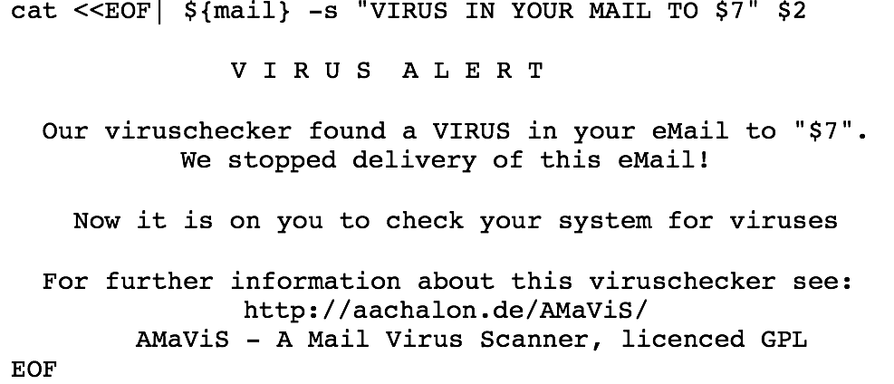
AMaViS: Execute Shell

Slide 16
novell-NLDAPsdk and BBS
The code uses a Blum-Blum-Shub (BBS) Generator as Fallback
Unfortunately it generates the random Seed (which is the important Component regarding Security of this Algorithm) from System Time
System Time has only a few Bits of Entropy
  Result: Can be guessed relatively easy and therefore weakens the whole Crypto building on it.

Slide 17
novell-NLDAPsdk and BBS
Lesson learned:
  #1: Do not use the System Time as random Source
  #2: Entropy is a valuable Resource. When you have n Bits of Entropy you will never get more from it with deterministic Operations, but it is possible to accidently reduce Entropy. (MD5 of 512 Bits of Entropy results in 128 Bits of Entropy)

Slide 18
CASA/novell-lum and the Password Salt
Salt is used to stop a Code Book Attack
novell-lum used static Salts
CASA used the Hash Value of the Password as Salt (therefore constant regarding Password)
  Result: Password can be cracked easily.
Lesson learned:
  use a random and changing Salt

Slide 19
CASA and the Password Cache
micasad secures the cached Password by XOR’ing it with the Output of C#’s Random() Function seeded with a Timestamp
  Result: Two values XOR’ed with the same Value can be XOR’ed together to remove the “Key”
  Result: Assuming 12 hrs Runtime needs 2^39 Operations to decrypt all Values
  Result: Random() is predictable if an Attacker knows the Output (no Forward Security); Timestamp is BAD

Slide 20
CASA and the Password Cache
Lessons learned:
  #1: In this Case using a Timestamp is ok but needs an additional Value which changes everytime (i.e. a Sequence Number)
  # 2: Better add an additional Secret (i.e. a Master Password)

Slide 21
CASA and the Password Store
CASA encrypts the Password Store with AES in CBC Mode
When calling RijndaelManaged.CreateEncryptor() the Initialisation Vector (IV) is not random/changing
  Result: Every Data encrypted under the same Key has the same IV which leaks Information about the first Plaintext Block

Slide 22
kopete and im.novell.com
Problem #1: The first Version of Kopete’s GW Plugin does not verify the SSL-Cert :(
  Result: Everyone can sniff/modify GWIM Traffic
Problem #2: The SSL-Cert for im.novell.com was incorrect because of CN=im.provo.novell.com and an unknown CA-Cert
  Result: Kopete opens a Accept/Reject Dialog

Slide 23
kopete and im.novell.com
Problem #3: interactive Cert Verification is not possible because the Cert and its Fingerprint is not displayed
  Result: Users start to click “Accept” to get their Work done
  Result: All GWIM can be sniffed.
Problem #4: All other GWIM Clients work without stumbling over the invalid Cert :(

Slide 24
kopete and im.novell.com
Lessons learned:
  #1: verify received Certs!
  #2: only use valid Certs ;-)
  #3: be as verbose as possible when using interactive Cert Verification
  #4: make needed CA-Certs available for your Clients (safely)

Slide 25
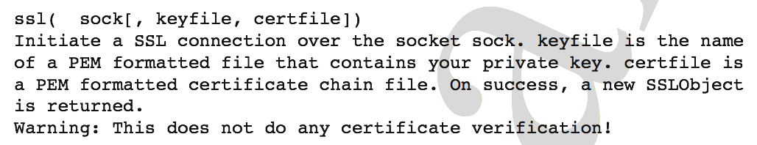
Red Carpet Client and Python
rug was written in Python and uses its HTTPSConnection Class
  Result: Everyone can sniff RC Traffic
Comment in Python Docmentation:

Slide 26
Red Carpet Client and Python
rug used HTTP Digest Authentication (HDA) encapsulated in SSL without Integrity Checking
  Result: After we broke the SSL Part we were able to read the Traffic in Plaintext. Without the Integrity Check from HDA we were also able to modify the command Stream!

Slide 27
Red Carpet Client and Python
Lessons learned:
  #1: RTFM ;-)
  #2: A Chain of Security Mechanisms is only as strong as its weakest Link
  #3: Use a secure SSL add-on for Python

Slide 28
novell-lum and User-friendliness
The Components communicate with the LDAP Server via an SSL connection
If the Component is not able to verify the Cert it uses the Callback Routine provided by OpenSSL to import a possibly missing CA-Cert - instead of using this Routine for interactive Verification (as designed) - and returns SUCCESS
  Result: Everyone can sniff/modify Traffic
  Result: Remote, un-authorized Logins

Slide 29
novell-lum and User-friendliness
Lessons learned:
  #1: RTFM ;-)
  #2: Do not try to be clever by assuming an Operation Environment/Security Policy. And do not use questionable Workarounds based on this Assumtions.

